Slide 1
HyperLapse
Manu Mitraan
S Balaji

Slide 2
Introduction
Hyperlapse (walklapse, space lapse, stop-motion time-lapse,moving timelapse) is a technique in time-lapse photography that allows the photographer move the camera a short distance between each shot.
It is simply a stabilized time lapse when the camera is motion

Slide 3
Problem Statement
Given a video and a speedup rate, create a hyperlapse for the given video

Slide 4
Naive approach
To get a speedup x sample 1 frame for every x frames
Problem:
Can lead to poor results as it can lead to picking frames that cannot be well stabilized

Slide 5
Other approach
Software based:
Perform stabilization and timelapse sequentially in either order
SFM for 3D reconstruction
Both stabilization and time lapse together
Hardware based:
Use mechanical means to dampen camera motion measured by inertial sensors

Slide 6
Advantage of our approach
Does not require any special sensor data, can be run on videos captured by any camera
Performs well in the presence of large moving foreground objects
Selection of frames driven by optimizing energy function, matching target rate, minimizing frame-frame motion, less complex than 3D approach

Slide 7
Overview
Frame-matching: using sparse feature-based techniques how well each frame can be aligned to its temporal neighbors and store these costs.
Frame-selection: dynamic programming algorithm finds an optimum path of frames that balances matching target rate and frame-frame motion.
Path smoothing and rendering: Smooth the camera path and render final hyperlapse result.

Slide 8
Cost Function
Frame Matching Cost:
This helps in generating smooth visual transition between the frames.
Velocity and acceleration Cost:
To account for the deviation from given target speed

Slide 9
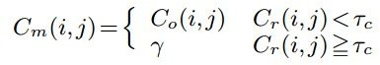
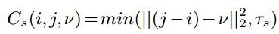
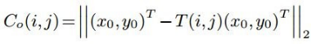
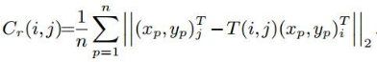
Cost Function contd.
Frame Matching Cost:
Velocity cost:
Acceleration cost:

Slide 10
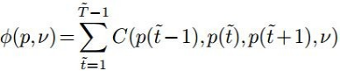
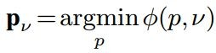
Optimum frame selection

Slide 11
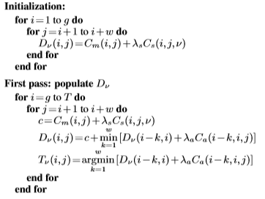
Algorithm (Path Selection)

Slide 12
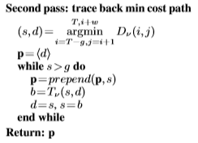
Algorithm (Path Selection) contd.

Slide 13
Results

Slide 14
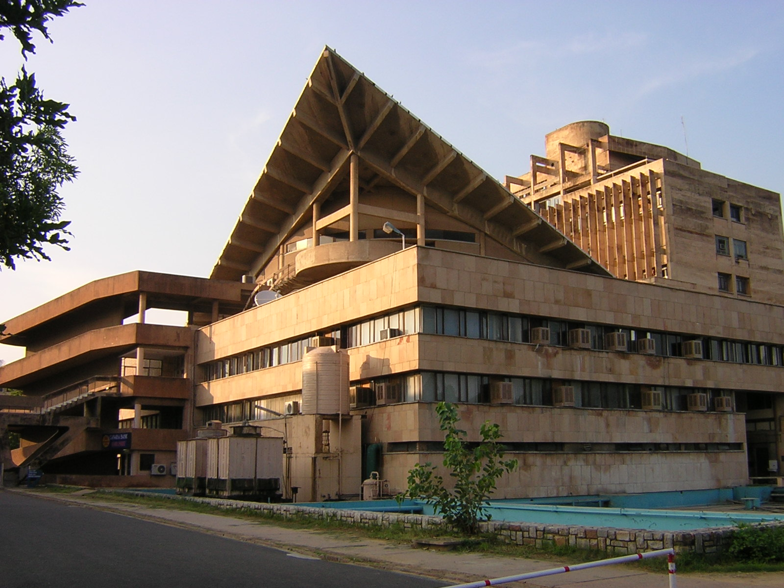
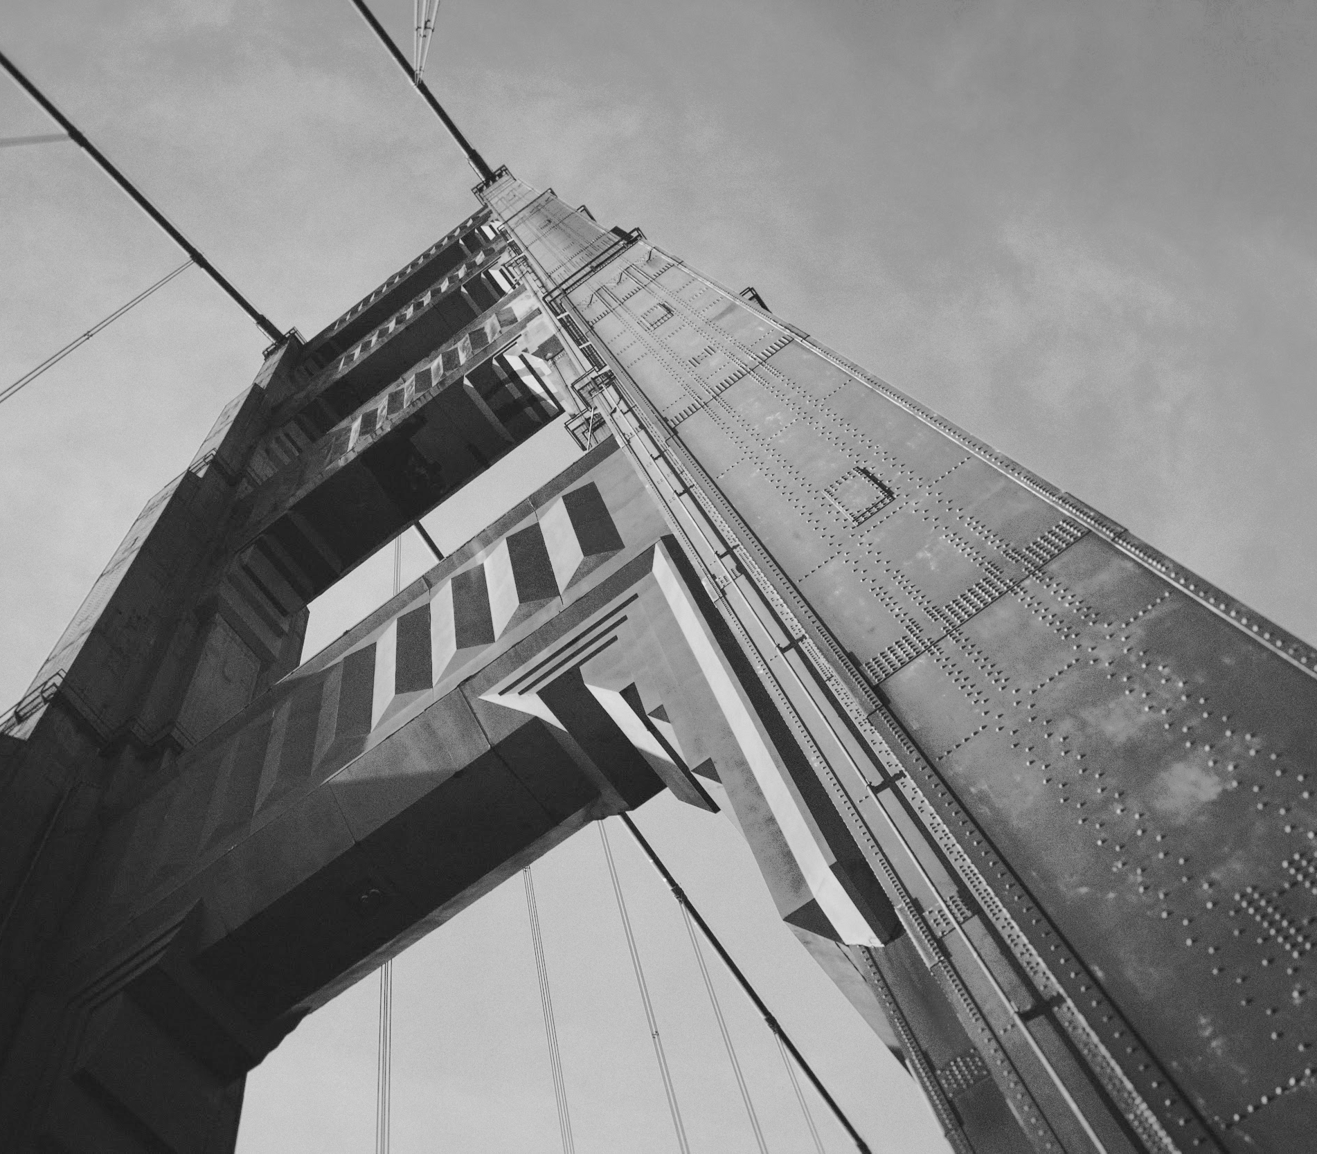
Thanks!
Based on:
N. Joshi et. al, Real-Time Hyperlapse Creation via Optimal Frame Selection

